Slide 1
Temporal Graphs in Scheduling
Philippe Laborie
plaborie@ilog.fr

Slide 2
Temporal Graphs in Scheduling
Overview
Motivations
Problem definition
Arc-consistency algorithms
  Single-Source Shortest Paths
Path-consistency algorithms
  All-Pairs Shortest Paths
Transitive Closure
Applications

Slide 3
Temporal Graphs in Scheduling
Overview
Motivations
Problem definition
Arc-consistency algorithms
  Single-Source Shortest Paths
Path-consistency algorithms
  All-Pairs Shortest Paths
Transitive Closure
Applications

Slide 4
Motivations
Scheduling
Scheduling is mainly about reasoning on the relative position of activities in time
Temporal constraints (d_{ij}≤t_{j}-t_{i}) are an important ingredient of scheduling
This lecture is only about propagating constraints of the form t_{i}+d_{ij}≤t_{j}
… sounds easy isn’t it ?

Slide 5
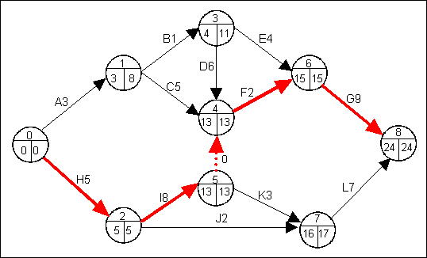
Motivations
Historical background: PERT
Program Evaluation and Review Technique
  Late 50s. Identification of critical paths in a project
  Complexity ?
Task/Duration
Identifier
3
Earliest time
4
11
Latest time
Time-point:
Start or end of task

Slide 6
Motivations
Limitations of Arc-Consistency
t_{i} +1 ≤ t_{j}
≡
t_{i}
1
t_{j}
1
1
1
1
1
1
t₀
1
t₁
1
t₂
1
t₃
1
t₄
1
t_{i}
1
1
t_{n}
[0,n]
[0,n]
[0,n]
[0,n]
[0,n]
[0,n]
[0,n]
n variables, O(n) constraints, propagation in O(n²)

Slide 7
Motivations
Limitations of Arc-Consistency
t_{i} +1 ≤ t_{j}
≡
t_{i}
1
t_{j}
1
[0,D]
t₀
t₁
[0,D]
1

Slide 8
Motivations
Limitations of Arc-Consistency
t_{i} +1 ≤ t_{j}
≡
t_{i}
1
t_{j}
1
[0,D-1]
t₀
t₁
[1,D]
1

Slide 9
Motivations
Limitations of Arc-Consistency
t_{i} +1 ≤ t_{j}
≡
t_{i}
1
t_{j}
1
[2,D-1]
t₀
t₁
[1,D-2]
1

Slide 10
Motivations
Limitations of Arc-Consistency
t_{i} +1 ≤ t_{j}
≡
t_{i}
1
t_{j}
1
[2,D-3]
t₀
t₁
[3,D-2]
1
2 variables, 2 constraints, propagation in O(D)
The propagation is even not polynomial in the
strong sense !

Slide 11

Motivations
Propagation of resource constraints
d_{ij}
t_{i} +d_{ij} ≤ t_{j}
≡
t_{i}
t_{j}
s_{A}
e_{A}
10
3
-12
s_{B}
5
e_{B}
If s_{A}< e_{B}, then e_{A} ≤ s_{B}

Slide 12
Temporal Graphs in Scheduling
Overview
Motivations
Problem definition
Arc-consistency algorithms
  Single-Source Shortest Paths
Path-consistency algorithms
  All-Pairs Shortest Paths
Transitive Closure
Applications

Slide 13
Problem definition
Simple Temporal Network (STN)
Input: A network of temporal constraints
  Origin time-point: t₀=0
  Variable time-points: t_{i}
  Temporal constraints: d_{ij} ≤t_{j}-t_{i,} d_{ij} ∈Z
Expressivity:
  Precedence constraints: t_{i} ≤ t_{j} (d_{ij}=0)
  Time-bound constraints: t_{i} ≤ d_{i} (j=0), d_{j} ≤ t_{j} (i=0)
  Min/Max delays: d_{ij} ≤ t_{j}-t_{i} ≤ e_{ij} (d_{ij} ≤ t_{j}-t_{i} ; -e_{ij} ≤ t_{j}-t_{i} )

Slide 14
Problem definition
Static problem
Given a network
  Is the network consistent ?
  If the network is consistent:
  What are the possible values of t_{i} (i∈[0,n]) ?
  What are the possible values of t_{j}-t_{i} (i,j∈[0,n]) ) ?
  Is t_{i} necessarily (possibly) before t_{j} ?

Slide 15
Problem definition
Incremental problem
Given a consistent network and a new constraint d_{uv} ≤t_{v}-t_{u}
  Is the network still consistent ?
  If the network is still consistent:
  What are the possible values of t_{i} (i∈[0,n]) ?
  What are the possible values of t_{j}-t_{i} (i,j∈[0,n]) ) ?
  Is t_{i} necessarily (possibly) before t_{j} ?

Slide 16
Problem definition
What we won’t talk about
Temporal reasoning in a broader sense
  Focus on STN
Fully dynamic algorithms
  Focus on constraint addition, no constraint removal
Queries in non-constant time
  Focus on graph algorithms that compute/maintain a structure so that all queries can be answered in O(1)

Slide 17
Problem definition
General results [Dechter&al 1991]
Good news:
All the mentioned problems are polynomial
Arc-consistency on constraints (d_{ij} ≤t_{j}-t_{i}) is equivalent to global consistency, it ensures a backtrack-free search
If the network is arc-consistent, the earliest (resp. the latest) dates in the domains of t_{i} is a solution

Slide 18
Problem definition
Graph notations
Directed Graph G=(V,E,w)
  E⊆V×V
  w: E→Z
Opposite graph: -G=(V,E,-w)
Transpose graph: G^{T}=(V,E^{T},w)
  E^{T}={(v_{j},v_{i})/(v_{i},v_{j})∈E}
w
v
u

Slide 19
Problem definition
Graph notations
Directed Graph G=(V,E,w)
Path: π = (v₀,…,v_{i},v_{i+1},…,v_{n})
∀i∈[0,n), (v_{i},v_{i+1})∈E
Path length: w(π)= Σ_{i} w(v_{i},v_{i+1})
Cycle: (v₀,…,v_{i},v_{i+1},…,v_{n})
(v_{n},v₀)∈E, ∀i∈[0,n), (v_{i},v_{i+1})∈E

Slide 20
Problem definition
Graph notations
Directed Graph G=(V,E,w)
  E⊆V×V
  w: E→Z
γ[G](u,v): length of a longest path between u and v in G
δ[G](u,v): length of a shortest path between u and v in G
Note: γ[G](u,v) = -δ[-G](u,v)

Slide 21
Problem definition
Graph representation
Directed Graph G=(V,E,w)
  V={t_{i}}
  E= {(t_{i},t_{j})/ ∃i,j, (d_{ij} ≤t_{j}-t_{i})}
  w(t_{i},t_{j}) = d_{ij}
d_{ij}
t_{j}
d_{0i}
t₀
t_{i}
d_{jk}
d_{ik}
d_{ki}
t_{k}

Slide 22
Temporal Graphs in Scheduling
Overview
Motivations
Problem definition
Arc-consistency algorithms
  Single-Source Shortest Paths
Path-consistency algorithms
  All-Pairs Shortest Paths
Transitive Closure
Applications

Slide 23
Arc-Consistency Algorithms
Static problem
Given a network
  Is the network consistent ?
  If the network is consistent:
  What are the possible values of t_{i} (i∈[0,n]) ?

Slide 24
Arc-Consistency Algorithms
Static problem
The network is consistent iff there is no positive cycles on the graph G=(V,E,w)
If there is no positive cycle in G, the possible values of t_{i} are [ γ[G](t₀,t_{i}), -γ[G](t_{i},t₀) ]
If there is no positive cycle in G, the possible values of t_{i} are [ γ[G](t₀,t_{i}), -γ[G^{T}](t₀,t_{i}) ]

Slide 25
Arc-Consistency Algorithms
Static problem: Example
Example
8
t₃
10
t₀
t₁
-3
2
-9
-7
t₂
-9
2
t₄
-15

Slide 26
Arc-Consistency Algorithms
Static problem: Example
Example
8
t₃
10
t₀
t₁
-3
2
-9
-7
t₂
-9
2
t₄
-15
Positive cycle: 10+8-3+2-15=2
The network is inconsistent

Slide 27
Arc-Consistency Algorithms
Static problem: Example
Example
8
t₃
10
t₀
t₁
-3
2
-9
-7
t₂
-15
2
t₄
-20

Slide 28
Arc-Consistency Algorithms
Static problem: Example
Example
8
t₃
10
t₀
t₁
-3
2
-9
-7
t₂
-9
2
t₄
-20
[17, ]

Slide 29
Arc-Consistency Algorithms
Static problem: Example
Example
8
t₃
10
t₀
t₁
-3
2
-9
-7
t₂
-9
2
t₄
-20
[17,18]

Slide 30
Arc-Consistency Algorithms
Static problem: Shortest Path formulation
The network is consistent iff there is no negative cycles on the graph -G=(V,E,-w)
If there is no negative cycle in -G, the possible values of t_{i} are: [ -δ[-G](t₀,t_{i}), δ[-G^{T}](t₀,t_{i}) ]
All those values can be computed by Single-Source Shortest Path algorithms on -G and -G^{T}

Slide 31
Arc-Consistency Algorithms
Static problem: Shortest Path formulation
For all our algorithms on arc-consistency we assume an adjacency list representation of the directed graph:
V: list of vertices (v₀,v₁,…,v_{n})
v₀: source vertex for shortest paths
For v∈V, Adj[v]: set of vertices adjacent to v

Slide 32
Arc-Consistency Algorithms
Static problem: Special cases
Special cases where the network is always consistent (no positive cycle in G):
  [DAG] G is an acyclic graph (DAG)
  [d≤0] All delays in G are negative
Shortest path formulation (On -G):
  [DAG] Shortest path on DAGs
  [d≤0] Shortest path on graph with positive weights

Slide 33
Arc-Consistency Algorithms
Static problem: Overview
Algorithm Complexity
Special cases
  DAG Topological sort O(n+m)
  d≤0 Dijkstra O(m+n.log(n))
General case Bellman-Ford-Moore O(n.m)
Goldberg-Radzic O(n.m)
All algorithms in O(n+m) in memory

Slide 34
Arc-Consistency Algorithms
Static problem: Label-Correcting Methods
All the algorithms we will see are based on the Label-Correcting Method
[Cormen&al 90][Tarjan 83]

Slide 35
Arc-Consistency Algorithms
Static problem: Label-Correcting Methods
Label Correcting Method
  For each vertex v, we maintain
    A value d[v] which is an upper-bound estimate on δ(v₀,v)
    A vertex status S[v]∈{unreached, label, scanned}
    A node π[v] which is the previous node of v in the shortest path estimate
INITIALIZE-SINGLE-SOURCE(G,v₀)
for each v ∈V
d[v]←∞
S[v]←unreached
π[v]←NIL
d[v₀]←0
S[v₀]←labeled
SCAN(u)
for each v in Adj[u]
if d[v] > d[u]+ w(u,v) then
d[v]←d[u]+ w(u,v)
S[v]←labeled
π[v]←u
S[u]←scanned

Slide 36
Arc-Consistency Algorithms
Static problem: Label-Correcting Methods
Label Correcting Method:
  L: set of currently labeled vertices
  If there is no negative cycle, the method is guaranteed to terminate
LABEL-CORRECTING(G,v₀)
INITIALIZE-SINGLE-SOURCE(G,v₀)
while L≠∅
select u∈L
SCAN(u)

Slide 37
Arc-Consistency Algorithms
Static problem: Special case [DAG]
DAG-Shortest Path algorithm
Idea:
  Scan the vertices in a topological order
  It ensures that each vertex is scan only once

Slide 38
Arc-Consistency Algorithms
Static problem: Special case [DAG]
DAG-Shortest Path algorithm
Topological sort: (v₀, v₁, v₃, v₄, v₂)
v₁
v₂
∞
1
∞
v₀
5
0
2
7
1
∞
∞
v₃
-5
v₄

Slide 39
Arc-Consistency Algorithms
Static problem: Special case [DAG]
DAG-Shortest Path algorithm
Topological sort: (v₀, v₁, v₃, v₄, v₂)
v₁
v₂
5
1
∞
v₀
5
0
2
7
1
7
∞
v₃
-5
v₄

Slide 40
Arc-Consistency Algorithms
Static problem: Special case [DAG]
DAG-Shortest Path algorithm
Topological sort: (v₀, v₁, v₃, v₄, v₂)
v₁
v₂
5
1
6
v₀
5
0
2
7
1
7
∞
v₃
-5
v₄

Slide 41
Arc-Consistency Algorithms
Static problem: Special case [DAG]
DAG-Shortest Path algorithm
Topological sort: (v₀, v₁, v₃, v₄, v₂)
v₁
v₂
5
1
6
v₀
5
0
2
7
1
7
2
v₃
-5
v₄

Slide 42
Arc-Consistency Algorithms
Static problem: Special case [DAG]
DAG-Shortest Path algorithm
Topological sort: (v₀, v₁, v₃, v₄, v₂)
v₁
v₂
5
1
3
v₀
5
0
2
7
1
7
2
v₃
-5
v₄

Slide 43
Arc-Consistency Algorithms
Static problem: Special case [DAG]
DAG-Shortest Path algorithm
Topological sort: (v₀, v₁, v₃, v₄, v₂)
v₁
v₂
5
1
3
v₀
5
0
2
7
1
7
2
v₃
-5
v₄

Slide 44
Arc-Consistency Algorithms
Static problem: Special case [DAG]
DAG-Shortest Path algorithm
Topological sort: (v₀, v₁, v₃, v₄, v₂)
v₁
v₂
5
1
3
v₀
5
0
2
7
1
7
2
v₃
-5
v₄

Slide 45
Arc-Consistency Algorithms
Static problem: Special case [DAG]
Topological sort algorithm
COMPUTE-INDEGREE(G)
for each u∈V
indegree[u]←0
for each u∈V
for each v∈Adj[u]
indegree[v]←indegree[v] +1
TOPOLOGICAL-SORT(G)
COMPUTE-INDEGREE(G)
for each u∈V
if (indegree[u]=0)
Q←{u}
while (Q≠∅) do
u←head[Q]
for each v in Adj[u]
indegree[v]←indegree[v]-1
if (indegree[v]=0)
Q←{v}
Time complexity: O(n+m)

Slide 46
Arc-Consistency Algorithms
Static problem: Special case [DAG]
DAG-Shortest Path algorithm
DAG-SHORTEST-PATH(G,v₀)
INITIALIZE-SINGLE-SOURCE(G,v₀)
T←TOPOLOGICAL-SORT(G)
for each v∈T
SCAN(v)
Time complexity: O(n+m)

Slide 47
Arc-Consistency Algorithms
Static problem: Special case [DAG]
Pure PERT problems can be solved in linear time using DAG-Shortest Path algorithm

Slide 48
Arc-Consistency Algorithms
Static problem: Special case [d≤0]
Dijkstra algorithm [Dijkstra-59]
Idea:
  Scan vertices starting from v₀
  Select a labeled node with minimum d[v] as the next node to be scanned
  It ensures that each vertex is scanned exactly only once

Slide 49
Arc-Consistency Algorithms
Static problem: Special case [d≤0]
Dijkstra algorithm [Dijkstra-59]
DIJKSTRA(G,v₀)
INITIALIZE-SINGLE-SOURCE(G,v₀)
Q←V
while Q≠∅
u←EXTRACT-MIN(Q)
SCAN(u)
Select vertex
with min d[v]
Decrease key of labeled
vertices
Time complexity: O(m+n.log(n)) with a Fibonacci heap

Slide 50
Arc-Consistency Algorithms
Static problem: Special case [d≤0]
u
v
u
v
1
1
10
∞
∞
10
10
∞
9
9
s
0
2
3
s
0
2
3
4
6
4
6
7
7
5
5
∞
∞
5
∞
2
2
x
y
x
y
u
v
u
v
1
1
8
14
10
8
13
10
9
9
2
3
s
0
2
3
s
0
4
6
4
6
7
7
5
5
5
7
5
7
2
2
x
y
x
y

Slide 51
Arc-Consistency Algorithms
Static problem: Special case [d≤0]
u
v
u
v
1
1
10
8
9
10
8
9
9
9
0
2
3
0
2
3
4
6
4
6
7
7
5
5
5
7
5
7
2
2
x
y
x
y

Slide 52
Arc-Consistency Algorithms
Static problem: Special case [d≤0]
Dijkstra algorithm
Many recent improvements on heap structures not detailed here
See for instance [Goldberg 01] for an overview of algorithms with complexity such as O(m+nloglogn) or O(m.n(logU loglogU)^{1/3}) where U denotes the biggest arc length

Slide 53
Arc-Consistency Algorithms
Static problem: General case
Bellman-Ford-Moore algorithm
[Bellman 58] [Moore 59] [Ford&Fulkerson 62]
Idea:
  Maintain labeled nodes in a FIFO queue
  If a node v has been scanned more than n times, there exists a negative cycle

Slide 54
Arc-Consistency Algorithms
Static problem: General case
Bellman-Ford-Moore algorithm (BFM)
[Bellman 58] [Moore 59] [Ford&Fulkerson 62]
BFM(G,v₀)
Q ←{v₀}
while Q≠∅
u←head[Q]
SCAN(u)
Add labeled vertices
in Q
Time complexity: O(n.m)

Slide 55
Arc-Consistency Algorithms
Static problem: General case
t
5
x
t
5
x
∞
-2
∞
6
-2
∞
6
6
-3
-3
s
0
8
s
0
8
-4
7
-4
7
2
2
7
7
∞
∞
7
∞
9
9
y
z
y
z
t
5
x
t
5
x
6
-2
4
2
-2
4
6
6
-3
-3
s
0
8
s
0
8
-4
7
-4
7
2
2
7
7
7
2
7
2
9
9
y
z
y
z

Slide 56
Arc-Consistency Algorithms
Static problem: General case
t
5
x
2
-2
4
6
-3
s
0
8
-4
7
2
7
7
−2
9
y
z

Slide 57
Arc-Consistency Algorithms
Static problem: General case
BFM algorithm has the best worst-case complexity O(n.m)
Many practical improvements to the basic BFM algorithm:
  Pape-Levit algorithm [Pape 74][Levit 72]: O(n2^{n})
  Pallottino algorithm [Pallottino 84]: O(n² m)
  Goldberg-Radzic [Goldberg&Radzic 93] : O(nm)

Slide 58
Arc-Consistency Algorithms
Static problem: General case
Goldberg-Radzic algorithm:
Idea:
  At a given state of the propagation, an arc (u,v) is said to be admissible iff d[v] > d[u]+ w(u,v) that is: scanning vertex u will update vertex v
  If both u and v are labeled and arc (u,v) is admissible then, it is better to scan u before v
  Assuming there is no negative cycle, the sub-graph of admissible arcs is acyclic

Slide 59
Arc-Consistency Algorithms
Static problem: General case
Goldberg-Radzic algorithm:
Idea:
  If both u and v are labeled and arc (u,v) is admissible it is better to scan u before v
  Assuming there is no negative cycle, the sub-graph of admissible arcs is acyclic
  Choose to scan first those labeled vertices that do not have any predecessor in the sub-graph of admissible arcs

Slide 60
Arc-Consistency Algorithms
Static problem: General case
Goldberg-Radzic algorithm:
  Can easily be adapted to the detection of negative cycles
  Has been shown to be robust on many graph topologies [Cherkassky&al 96]
  Interesting property: if the graph is acyclic, same complexity as the pulling algorithm: O(n+m)

Slide 61
Arc-Consistency Algorithms
Incremental problem
How to compare the complexity of incremental algorithms ?
Bounded Incremental Computation (BIC)
(also known as “output complexity”)
[Ramalingam&Reps 96]

Slide 62
Arc-Consistency Algorithms
Incremental problem: BIC
Bounded Incremental Computation
Algorithm
x
f(x)
x+Δx
f(x+Δx)
  │Δ│ : Size of the change in the input and output
  Complexity of the incremental algorithm is characterized in terms of │Δ│

Slide 63
Arc-Consistency Algorithms
Incremental problem: BIC
Bounded Incremental Computation
Application to Single-Source Shortest Path algorithm:
  │Δ│ : number of vertices v whose shortest path δ(v₀,v) has changed (affected vertices)
  ║Δ║ : number of arcs with at least one affected end-point

Slide 64
Arc-Consistency Algorithms
Incremental problem: BIC
Bounded Incremental Computation
  Bounded Incremental Algorithms
    Polynomial in │Δ│ (or ║Δ║)
    Exponential in │Δ│ (or ║Δ║)
  Unbounded Incremental Algorithms

Slide 65
Arc-Consistency Algorithms
Incremental problem: Overview
Algorithm Complexity
Special cases
  DAG, d>0 Michel&al O(║Δ║+│Δ│log│Δ│)
  d≥0 Gerevini&al
  No ≥0 cycle Ramalingam&Reps O(║Δ║+│Δ│log│Δ│)
General case Frigioni&al O(min(m,k.│Δ│).log(n))
  Cesta&Oddi O(│Δ│.║Δ║)
All algorithms in O(n+m) in memory

Slide 66
Arc-Consistency Algorithms
Michel&VanHentenryck algorithm
[Michel&VanHentenryck 03]
Restriction: DAG, d>0 (w<0)
Best static algorithm: DAG-ShortestPath
Idea:
  The shortest path lengths before insertion δ(v₀,v) in decreasing order represent a topological order of the affected vertices v
  Affected vertices are dynamically ordered when visited using a heap

Slide 67
Arc-Consistency Algorithms
Michel&VanHentenryck algorithm
Each labeled vertex is scanned exactly once and only affected vertices are scanned
Complexity: O(║Δ║+│Δ│log │Δ│)
INSERT-ARC-MVH(G,u→v)
G←G∪{u→v}
Q←{u}
while Q≠∅
u←EXTRACT-MAX(Q)
SCAN(u)
Select vertex
with max δ(v₀,u)
Add labeled vertices
In the heap

Slide 68
Arc-Consistency Algorithms
Coming soon …
Irit Katriel talk, CP-AI-OR 04
Restriction: DAG
Complexity: O(║Δ║+│Δ│log │Δ│)

Slide 69
Arc-Consistency Algorithms
Gerevini algorithm
[Gerevini&al 96]
Restriction: d≥0 (w≤0)
Idea: incrementally:
  Detects <-length cycles
  Merges all vertices in 0-length cycles (“meta-graph” or condensation graph)
  Maintains a topological sort of the DAG that represents the meta-graph and use it to compute shortest paths

Slide 70
Arc-Consistency Algorithms
Ramalingam&Reps algorithm
[Ramalingam&Reps 96]
Restriction: no negative cycles in G
Adaptation of Dijkstra algorithm using an idea of [Edmonds&Karp 72]:
Shortest paths are unchanged if path lengths w(u,v) are replaced by w_{f}(u,v)=f(u)+w(u,v)-f(v)
If f is “well” chosen, all path length w_{f}(u,v) can be non-negative

Slide 71
Arc-Consistency Algorithms
Ramalingam&Reps algorithm
Restriction: no negative cycles in G
Adaptation of Dijkstra algorithm using an idea of [Edmonds&Karp 72]:
Shortest paths are unchanged if path lengths w(u,v) are replaced by w_{f}(u,v)=f(u)+w(u,v)-f(v)
Reduced distances: f(u)=d_{OLD}[u]
If u is reachable from the source (d_{OLD}[u]), by definition, w_{f}(u,v)= d_{OLD}[u] +w(u,v)- d_{OLD}[v] ≥ 0

Slide 72
Arc-Consistency Algorithms
Ramalingam&Reps algorithm
Restriction: no negative cycles in G
Adaptation of Dijkstra algorithm using an idea of [Edmonds&Karp 72]:
Shortest paths are unchanged if path lengths w(u,v) are replaced by w_{f}(u,v)=f(u)+w(u,v)-f(v)
The algorithm applies an adaptation of Dijkstra algorithm on the modified graph
Complexity in O(║Δ║+│Δ│log│Δ│)

Slide 73
Arc-Consistency Algorithms
Frigioni algorithm
[Frigioni&al 03]
General case
Another adaptation of Dijkstra algorithm using the idea of [Edmonds&Karp 72]
Complexity in O(min(m,k.│Δ│).log(n)) where G has a k-bounded accounting function

Slide 74
Arc-Consistency Algorithms
Cesta&Oddi algorithm
[Cesta&Oddi 01]
Incremental version of the Bellman-Ford-Moore algorithm
Ideas:
  Compute the Single-Source Shortest Path algorithms on -G (min) and -G^{T} (max) simultaneously
  Efficient negative cycle detection

Slide 75
Arc-Consistency Algorithms
Cesta&Oddi algorithm
Incremental Bellman-Ford …
INSERT-ARC-CO(G,u→v)
du←d[0,u]
dv←d[v,0]
Q ←{u}
while Q≠∅
u←Dequeue[Q]
if SCAN-CO(u)
then continue
else return INCOHERENT
if du≠d[0,u] or dv≠d[v,0]
then return INCOHERENT
SCAN-CO(u)
for each v∈Out[u]
if d[0,v] > d[0,u]+ w(u,v) then
if d[0,v]+d[v,0] < 0 return FALSE
d[0,v]←d[0,u]+ w(u,v)
if v∉Q then Q←Q∪{v}
for each v∈In[u]
if d[v,0] > d[u,0]+ w(v,u) then
if d[0,v]+d[v,0] < 0 return FALSE
d[v,0]←d[u,0]+ w(v,u)
if v∉Q then Q←Q∪{v}

Slide 76
Arc-Consistency Algorithms
Cesta&Oddi algorithm
… simultaneous computation of both paths
INSERT-ARC-CO(G,u→v)
du←d[0,u]
dv←d[v,0]
Q ←{u}
while Q≠∅
u←Dequeue[Q]
if SCAN-CO(u)
then continue
else return INCOHERENT
if du≠d[0,u] or dv≠d[v,0]
then return INCOHERENT
SCAN-CO(u)
for each v∈Out[u]
if d[0,v] > d[0,u]+ w(u,v) then
if d[0,v]+d[v,0] < 0 return FALSE
d[0,v]←d[0,u]+ w(u,v)
if v∉Q then Q←Q∪{v}
for each v∈In[u]
if d[v,0] > d[u,0]+ w(v,u) then
if d[0,v]+d[v,0] < 0 return FALSE
d[v,0]←d[u,0]+ w(v,u)
if v∉Q then Q←Q∪{v}

Slide 77
Arc-Consistency Algorithms
Cesta&Oddi algorithm
… with negative cycle detection
INSERT-ARC-CO(G,u→v)
du←d[0,u]
dv←d[v,0]
Q ←{u}
while Q≠∅
u←Dequeue[Q]
if SCAN-CO(u)
then continue
else return INCOHERENT
if du≠d[0,u] or dv≠d[v,0]
then return INCOHERENT
SCAN-CO(u)
for each v∈Out[u]
if d[0,v] > d[0,u]+ w(u,v) then
if d[0,v]+d[v,0] < 0 return FALSE
d[0,v]←d[0,u]+ w(u,v)
if v∉Q then Q←Q∪{v}
for each v∈In[u]
if d[v,0] > d[u,0]+ w(v,u) then
if d[0,v]+d[v,0] < 0 return FALSE
d[v,0]←d[u,0]+ w(v,u)
if v∉Q then Q←Q∪{v}

Slide 78
Temporal Graphs in Scheduling
Overview
Motivations
Problem definition
Arc-consistency algorithms
  Single-Source Shortest Paths
Path-consistency algorithms
  All-Pairs Shortest Paths
Transitive Closure
Applications

Slide 79
Path-Consistency Algorithms
Static problem
Given a network
  Is the network consistent ?
  If the network is consistent:
  What are the possible values of t_{j}-t_{i} (i,j∈[0,n]) ) ?

Slide 80
Path-Consistency Algorithms
Static problem: Shortest Path formulation
The network is consistent iff there is no negative cycles on the graph -G=(V,E,-w)
If there is no negative cycle in -G, the possible values of t_{j}-t_{i} are: [ -δ[-G](t_{i},t_{j}), δ[-G^{T}](t_{i},t_{j}) ]
All those values can be computed by All-Pairs Shortest Path algorithms on -G and -G^{T}

Slide 81
Path-Consistency Algorithms
Static problem: Overview
Algorithm Complexity
General case Floyd-Warshall O(n³)
Johnson O(n.m+n²log n)
All algorithms in O(n²) in memory

Slide 82
Path-Consistency Algorithms
Floyd-Warshall algorithm
Idea: dynamic programming
  Let V={u₁,…,u_{n}} and for k≤n, V_{k}={u₁,…,u_{k}}
  For any pair of vertices u_{i},u_{j}∈V, consider all paths from u_{i} to u_{j} whose intermediate vertices are all drawn from V_{k} and let p be a shortest path among them
V_{k}
p
u_{i}
u_{j}

Slide 83
Path-Consistency Algorithms
Floyd-Warshall algorithm
Idea: dynamic programming
  If u_{k} is not in p, then a shortest path from u_{i} to u_{j} with all intermediate vertices in V_{k-1} is also a shortest path in V_{k}
  If u_{k} is in p, then we break down p into p₁ and p₂ where
    p₁ is the shortest path from u_{i} to u_{k} with all intermediate vertices in V_{k-1}
    p₂ is the shortest path from u_{k} to u_{j} with all intermediate vertices in V_{k-1}

Slide 84
Path-Consistency Algorithms
Floyd-Warshall algorithm
Idea: dynamic programming
  d_{ij}^{(k)}: weight of the shortest path from u_{i} to u_{j} with all intermediate vertices in V_{k}
  d_{ij}⁽⁰⁾=w_{ij}
  d_{ij}^{(k)}=min (d_{ij}^{(k-1)}, d_{ik}^{(k-1)}+ d_{kj}^{(k-1)}) for k≥1

Slide 85
Path-Consistency Algorithms
Floyd-Warshall algorithm
FLOYD-WARSHALL(G)
for i,j in [1..n]
d[i,j]=w(u_{i},u_{j})
for k in [1..n]
for i in [1..n]
for j in [1..n]
d[i,j]=min(d[i,j],d[i,k]+d[k,j])
Time complexity: O(n³)

Slide 86
Path-Consistency Algorithms
Johnson algorithm
Idea: use SSSP algorithms
  All-Pairs Shortest Path = n Single-Source Shortest Path
  Use (again) the idea of [Edmonds&Karp 72]: shortest paths are unchanged if path lengths w(v_{i},v_{j}) are replaced by w_{f}(v_{i},v_{j})= f(v_{i}) +w(v_{i},v_{j}) -f(v_{j})
  Create a new graph G’=(V’,E’,w’) where:
    V’=V∪{s}
    E’=E∪{(s,v), v∈V}
    w’(s,v)=0, w’(v_{i},v_{j})= w(v_{i},v_{j})

Slide 87
Path-Consistency Algorithms
Johnson algorithm
Idea: use SSSP algorithms
  Create a new graph G’=(V’,E’,w’) where:
    V’=V∪{s}
    E’=E∪{(s,v), v∈V}
    w’(s,v)=0, w’(v_{i},v_{j})= w(v_{i},v_{j})
  For all v_{i},v_{j} we have:
    δ[G’](s,v_{i}) +w(v_{i},v_{j}) - δ[G’](s,v_{j}) ≥0
  Using f(v)= δ[G’](s,v) leads to a reweighted graph with positive length arcs

Slide 88
Path-Consistency Algorithms
Johnson algorithm
Idea: use SSSP algorithms
  δ[G’](s,v) can be computed by a BFM algorithm in O(n.m)
  For a given i, all δ[G](v_{i},v_{j}) can be computed by a Dijkstra algorithm on the reweighted graph
  Overall complexity: 1 BFM + n Dijkstra
  = O(n.m) + n.O(m+nlog n) = O(n.m+n²log n)
  Johnson algorithm is more efficient than Floyd-Warshall on sparse graphs (m<<n²)

Slide 89
Path-Consistency Algorithms
Incremental problem
Given a consistent network and a new constraint d_{uv} ≤t_{v}-t_{u}
  Is the network still consistent ?
  If the network is still consistent:
  What are the possible values of t_{j}-t_{i} (i,j∈[0,n]) ) ?

Slide 90
Path-Consistency Algorithms
Incremental problem: Overview
Algorithm Complexity
General case Simple algorithm O(n²)
Cesta-Oddi O(n²)
All algorithms in O(n²) in memory

Slide 91
Path-Consistency Algorithms
Simple algorithm
Simple algorithm
w_{ij}
INSERT-ARC-SIMPLE(G,u_{i}→u_{j})
if (w_{ij} + d[j,i]<0)
return INCOHERENT
for k in [1..n]
for l in [1..n]
d[k,l]=min(d[k,l],d[k,i]+ w_{ij}+d[j,l])
u_{i}
u_{j}
u_{k}
u_{l}
Time complexity: O(n²)

Slide 92
Path-Consistency Algorithms
Cesta&Oddi algorithm
[Cesta&Oddi 01]
Adaptation of [Ausiello&al 91]
Idea:
x
y
u_{i}
u_{j}
ANC(u_{i})
DESC(u_{j})

Slide 93
Path-Consistency Algorithms
Cesta&Oddi algorithm
Idea: adding w(u_{i},u_{j}) changes the shortest path (x,y) iff it also changes all the intermediary shortest paths (x,y_{k}) and (x_{l},y)
?
x
y
y_{k}
y
u_{i}
u_{j}
ANC(u_{i})
DESC(u_{j})

Slide 94
Path-Consistency Algorithms
Cesta&Oddi algorithm
Worse case complexity in O(n²) but more efficient than the simple algorithm as many unchanged pairs (x,y) are not scanned

Slide 95
Temporal Graphs in Scheduling
Overview
Motivations
Problem definition
Arc-consistency algorithms
  Single-Source Shortest Paths
Path-consistency algorithms
  All-Pairs Shortest Paths
Transitive Closure
Applications

Slide 96
Transitive Closure
Static problem
Given a network with only symbolic temporal constraints: t_{i} ≤ t_{j}
  Is t_{i} necessarily (possibly) before t_{j} ?

Slide 97
Transitive Closure
Static problem: Graph formulation
Given a network with only symbolic temporal constraints: t_{i} ≤ t_{j}
  t_{i} is necessarily before t_{j} iff there exists a path from t_{i} to t_{j} in G
  t_{i} is possibly before t_{j} iff there exists no path from t_{j} to t_{i} in G
  Can be answered in O(1) by computing the transitive closure of ≤

Slide 98
Transitive Closure
Static problem: Overview
Algorithm Complexity
General case Warshall O(n³)
StrongComponents-DAG O(n.m)
All algorithms in O(n²) in memory

Slide 99
Transitive Closure
Static problem: Warshall algorithm
[Warshall 62]
Warshall's algorithm is a specialized (but earlier) version of Floyd-Warshall algorithm

Slide 100
Transitive Closure
Static problem: Warshall algorithm
w(u_{i},u_{j}) is true if and only if there exists an arc (u_{i},u_{j})
WARSHALL(G)
for i,j in [1..n]
p[i,j]=w(u_{i},u_{j})
for k in [1..n]
for i in [1..n]
for j in [1..n]
if not p[i,j]
p[i,j]=p[i,k] and p[k,j])
Time complexity: O(n³)

Slide 101
Transitive Closure
Static problem: Strong Component + DAG
For instance: [Nuutila 94]
Those algorithms work in two steps:
  Detect strong components on G
  Compute transitive closure of the condensation graph (DAG)
Strong component: subset of vertices U such that for all (u,v)∈U there exists a path between u and v and a path between v and u in G

Slide 102
Transitive Closure
Static problem: Strong Component + DAG
Step 1: Strong Component Detection
C(u₀)
C(u₁)
u₃
u₀
u₁
C(u₆)
u₂
u₆
C(u₄)
u₅
u₄

Slide 103
Transitive Closure
Static problem: Strong Component + DAG
Step 2: TC on Condensation graph
C(u₀)
C(u₁)
C(u₆)
C(u₄)

Slide 104
Transitive Closure
Static problem: Strong Component + DAG
Strong components detection
[Tarjan 72]
Complexity in O(n+m)

Slide 105
Transitive Closure
Static problem: Strong Component + DAG
Transitive Closure of a DAG: O(n.m)
Idea: Compute the closure in reverse topological order
S(u₀)= {u₁}∪S(u₁)∪{u₄}∪S(u₄)={u₁,u₄,u₆}
u₀
S(u₁)= {u₆}∪S(u₆)={u₆}
u₁
S(u₆)={}
u₄
u₆
S(u₄)= {u₆}∪S(u₆)={u₆}

Slide 106
Transitive Closure
Incremental: Overview
Algorithm Complexity
General case Simple algorithm O(n²)
Italiano O(n) (amortized)
All algorithms in O(n²) in memory

Slide 107
Transitive Closure
Simple algorithm
Simple algorithm
x
y
u_{i}
u_{j}
p(u_{i})\p(u_{j})
s(u_{j})

Slide 108
Transitive Closure
Simple algorithm
Simple algorithm
INSERT-ARC-SIMPLE(G,u_{i}→u_{j})
if p[j,i]
return INCOHERENT
for k in [1..n]
if p[k,i] and not p[k,j]
for l in [1..n]
if p[j,l]
if not p[k,l]
p[k,l]=true
Time complexity: O(n²)

Slide 109
Transitive Closure
Italiano algorithm
[Italiano 86]
Idea:
  Maintain each set of successors s(x) as a spanning tree rooted at x
  When a new arc (u_{i},u_{j}) is inserted, efficiently update the spanning trees of successors s(x) of the predecessors of u_{i} that are not already predecessor of u_{j}.
  O(m) arc insertions can be performed in O(n.m)

Slide 110
Temporal Graphs in Scheduling
Overview
Motivations
Problem definition
Arc-consistency algorithms
  Single-Source Shortest Paths
Path-consistency algorithms
  All-Pairs Shortest Paths
Transitive Closure
Applications

Slide 111

Application
CP on Resources: Discrete Resources
Discrete Resource
Availability
Q
0
Time
A requires(q_{A}) R
B requires (q_{B}) R

Slide 112

Application
CP on Resources: Reservoir Resources
Reservoir
Level
Q
0
Time
A consumes(q_{A}) R
C produces (q_{C}) R
B requires (q_{B}) R

Slide 113
Applications
CP on Resources: Precedence Graph
Precedence Graph
  Events x=(t_{x},Δq_{x}) where the availability of a resource changes
  Arcs : Two kind of arcs: t_{x}<t_{y} and t_{x}≤ t_{y}
+2
+2
Activity
{
Production
-2
+2
Event
[-10,-5]
Consumption
-1
{
<
Arc
≤
Notes:
On a unary resource, an easy way to characterize a solution is that all the activities on the resource must be ordered. It allows to define the notion of rank of an activity in a solution.
Using this notion of rank, we can easily distinguish between the search procedures based on activity interactions on unary resources ;
1. Chronological Ranking selects at each search node an activity to be ranked first (before all the other ones) among the ones that are still unranked. In case of failure, the alternative is to enforce that at least one of the unranked activities executes before the selected one. Of course anti-chronological ranking may also be used.
2. Pair Sequencing selects at each search node a pair of activities to be sequenced one just after the other. In case of failure the alternative consists in enforcing that at least one activity is executed between the two selected ones. This family of goal is useful when dealing with transition costs.
3. Pair Ordering selects at each search node a pair of activities to be ordered. In the left branch it enforces one ordering of the activities and, in case of failure, in the other branch it enforce the other ordering. Note that pair ordering is the only search procedure that ensures that the constraints posted on the left and on the right branch are of the same nature (both are precedence relations).
In the next slides, we will propose two new instances of very simple search procedures based on Pair Ordering.

Slide 114
Applications
CP on Resources: Precedence Graph
Transitive closure is incrementally maintained using an adapted version of the simple incremental TC algorithm for handling both < and ≤ relations
Notes:
On a unary resource, an easy way to characterize a solution is that all the activities on the resource must be ordered. It allows to define the notion of rank of an activity in a solution.
Using this notion of rank, we can easily distinguish between the search procedures based on activity interactions on unary resources ;
1. Chronological Ranking selects at each search node an activity to be ranked first (before all the other ones) among the ones that are still unranked. In case of failure, the alternative is to enforce that at least one of the unranked activities executes before the selected one. Of course anti-chronological ranking may also be used.
2. Pair Sequencing selects at each search node a pair of activities to be sequenced one just after the other. In case of failure the alternative consists in enforcing that at least one activity is executed between the two selected ones. This family of goal is useful when dealing with transition costs.
3. Pair Ordering selects at each search node a pair of activities to be ordered. In the left branch it enforces one ordering of the activities and, in case of failure, in the other branch it enforce the other ordering. Note that pair ordering is the only search procedure that ensures that the constraints posted on the left and on the right branch are of the same nature (both are precedence relations).
In the next slides, we will propose two new instances of very simple search procedures based on Pair Ordering.

Slide 115
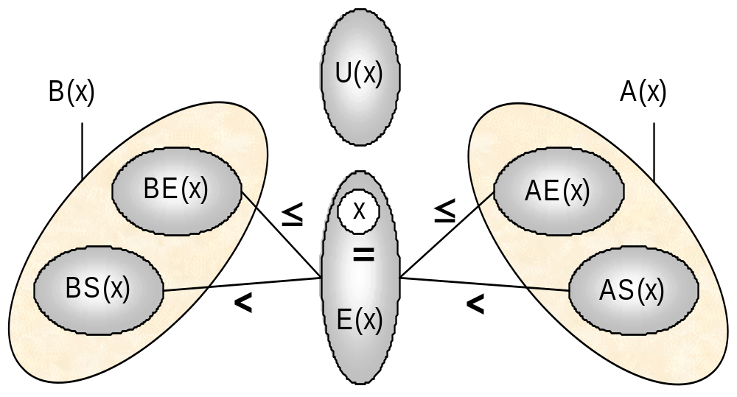
Applications
CP on Resources: Precedence Graph
Partition for an event x in a precedence graph
Traversing a subset Θ(x) has a complexity in⏐Θ(x)⏐
Notes:
On a unary resource, an easy way to characterize a solution is that all the activities on the resource must be ordered. It allows to define the notion of rank of an activity in a solution.
Using this notion of rank, we can easily distinguish between the search procedures based on activity interactions on unary resources ;
1. Chronological Ranking selects at each search node an activity to be ranked first (before all the other ones) among the ones that are still unranked. In case of failure, the alternative is to enforce that at least one of the unranked activities executes before the selected one. Of course anti-chronological ranking may also be used.
2. Pair Sequencing selects at each search node a pair of activities to be sequenced one just after the other. In case of failure the alternative consists in enforcing that at least one activity is executed between the two selected ones. This family of goal is useful when dealing with transition costs.
3. Pair Ordering selects at each search node a pair of activities to be ordered. In the left branch it enforces one ordering of the activities and, in case of failure, in the other branch it enforce the other ordering. Note that pair ordering is the only search procedure that ensures that the constraints posted on the left and on the right branch are of the same nature (both are precedence relations).
In the next slides, we will propose two new instances of very simple search procedures based on Pair Ordering.

Slide 116
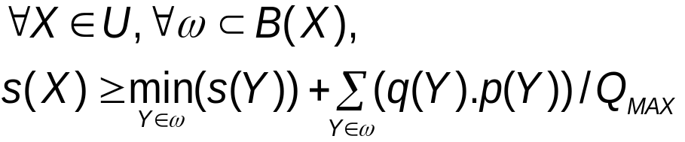
Applications
CP on Resources: Energy precedence
Energy Precedence Propagation [Laborie 01]
  Local Property:
  In a partial schedule, we can decline this property to perform constraint propagation
Notes:
On a unary resource, an easy way to characterize a solution is that all the activities on the resource must be ordered. It allows to define the notion of rank of an activity in a solution.
Using this notion of rank, we can easily distinguish between the search procedures based on activity interactions on unary resources ;
1. Chronological Ranking selects at each search node an activity to be ranked first (before all the other ones) among the ones that are still unranked. In case of failure, the alternative is to enforce that at least one of the unranked activities executes before the selected one. Of course anti-chronological ranking may also be used.
2. Pair Sequencing selects at each search node a pair of activities to be sequenced one just after the other. In case of failure the alternative consists in enforcing that at least one activity is executed between the two selected ones. This family of goal is useful when dealing with transition costs.
3. Pair Ordering selects at each search node a pair of activities to be ordered. In the left branch it enforces one ordering of the activities and, in case of failure, in the other branch it enforce the other ordering. Note that pair ordering is the only search procedure that ensures that the constraints posted on the left and on the right branch are of the same nature (both are precedence relations).
In the next slides, we will propose two new instances of very simple search procedures based on Pair Ordering.

Slide 117
Applications
CP on Resources: Energy precedence
Energy Precedence Propagation
Discrete resource: ∀ X ∈ U,
B
p=4, q=2
Q_{MAX}=2
B
p=4, q=2
9
C
p=4, q=1
X
⇒
C
p=4, q=1
X
E
E
D
D
p=2
q=2
p=2
q=2
p=2
q=1
p=2
q=1
0
0
Notes:
On a unary resource, an easy way to characterize a solution is that all the activities on the resource must be ordered. It allows to define the notion of rank of an activity in a solution.
Using this notion of rank, we can easily distinguish between the search procedures based on activity interactions on unary resources ;
1. Chronological Ranking selects at each search node an activity to be ranked first (before all the other ones) among the ones that are still unranked. In case of failure, the alternative is to enforce that at least one of the unranked activities executes before the selected one. Of course anti-chronological ranking may also be used.
2. Pair Sequencing selects at each search node a pair of activities to be sequenced one just after the other. In case of failure the alternative consists in enforcing that at least one activity is executed between the two selected ones. This family of goal is useful when dealing with transition costs.
3. Pair Ordering selects at each search node a pair of activities to be ordered. In the left branch it enforces one ordering of the activities and, in case of failure, in the other branch it enforce the other ordering. Note that pair ordering is the only search procedure that ensures that the constraints posted on the left and on the right branch are of the same nature (both are precedence relations).
In the next slides, we will propose two new instances of very simple search procedures based on Pair Ordering.

Slide 118
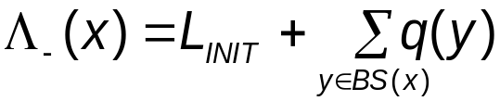

Applications
CP on Resources: Balance constraint
Reservoir Balance Propagation [Laborie 01]
  Local property: for a given event x in a solution schedule, we can compute the level of the reservoir just before x at date t(x)-ε as:
  A schedule is a solution on the reservoir iff
  In a partial schedule, we can decline this property to perform constraint propagation
Notes:
On a unary resource, an easy way to characterize a solution is that all the activities on the resource must be ordered. It allows to define the notion of rank of an activity in a solution.
Using this notion of rank, we can easily distinguish between the search procedures based on activity interactions on unary resources ;
1. Chronological Ranking selects at each search node an activity to be ranked first (before all the other ones) among the ones that are still unranked. In case of failure, the alternative is to enforce that at least one of the unranked activities executes before the selected one. Of course anti-chronological ranking may also be used.
2. Pair Sequencing selects at each search node a pair of activities to be sequenced one just after the other. In case of failure the alternative consists in enforcing that at least one activity is executed between the two selected ones. This family of goal is useful when dealing with transition costs.
3. Pair Ordering selects at each search node a pair of activities to be ordered. In the left branch it enforces one ordering of the activities and, in case of failure, in the other branch it enforce the other ordering. Note that pair ordering is the only search procedure that ensures that the constraints posted on the left and on the right branch are of the same nature (both are precedence relations).
In the next slides, we will propose two new instances of very simple search procedures based on Pair Ordering.

Slide 119

Applications
CP on Resources: Balance constraint
Reservoir Balance Propagation
  Given an event x, we can compute an upper bound
  on the reservoir level at date t(x)-ε assuming:
    All the production events y that may be executed strictly before x are executed strictly before x and produce their maximal quantity q(y);
    All the consumption events y that need to be executed strictly before x are executed strictly before x and consume their minimal quantity q(y);
    All the consumption events that may be executed simultaneously or after x are executed simultaneously or after x
Notes:
On a unary resource, an easy way to characterize a solution is that all the activities on the resource must be ordered. It allows to define the notion of rank of an activity in a solution.
Using this notion of rank, we can easily distinguish between the search procedures based on activity interactions on unary resources ;
1. Chronological Ranking selects at each search node an activity to be ranked first (before all the other ones) among the ones that are still unranked. In case of failure, the alternative is to enforce that at least one of the unranked activities executes before the selected one. Of course anti-chronological ranking may also be used.
2. Pair Sequencing selects at each search node a pair of activities to be sequenced one just after the other. In case of failure the alternative consists in enforcing that at least one activity is executed between the two selected ones. This family of goal is useful when dealing with transition costs.
3. Pair Ordering selects at each search node a pair of activities to be ordered. In the left branch it enforces one ordering of the activities and, in case of failure, in the other branch it enforce the other ordering. Note that pair ordering is the only search procedure that ensures that the constraints posted on the left and on the right branch are of the same nature (both are precedence relations).
In the next slides, we will propose two new instances of very simple search procedures based on Pair Ordering.

Slide 120



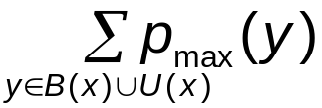
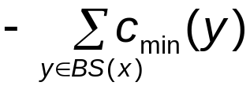
Applications
CP on Resources: Balance constraint
U(x)
BE(x)
AE(x)
≤
≤
<
x
<
☞
BS(x)
E(x)
AS(x)
Notes:
On a unary resource, an easy way to characterize a solution is that all the activities on the resource must be ordered. It allows to define the notion of rank of an activity in a solution.
Using this notion of rank, we can easily distinguish between the search procedures based on activity interactions on unary resources ;
1. Chronological Ranking selects at each search node an activity to be ranked first (before all the other ones) among the ones that are still unranked. In case of failure, the alternative is to enforce that at least one of the unranked activities executes before the selected one. Of course anti-chronological ranking may also be used.
2. Pair Sequencing selects at each search node a pair of activities to be sequenced one just after the other. In case of failure the alternative consists in enforcing that at least one activity is executed between the two selected ones. This family of goal is useful when dealing with transition costs.
3. Pair Ordering selects at each search node a pair of activities to be ordered. In the left branch it enforces one ordering of the activities and, in case of failure, in the other branch it enforce the other ordering. Note that pair ordering is the only search procedure that ensures that the constraints posted on the left and on the right branch are of the same nature (both are precedence relations).
In the next slides, we will propose two new instances of very simple search procedures based on Pair Ordering.

Slide 121
Applications
CP on Resources: Balance constraint
Reservoir Balance Propagation
  Similar bounds can be computed:
    Lower bound on the reservoir level at date t(x)-ε
    Lower/Upper bound on the reservoir level at date t(x)+ε
  For symmetry reason, we focus on
Notes:
On a unary resource, an easy way to characterize a solution is that all the activities on the resource must be ordered. It allows to define the notion of rank of an activity in a solution.
Using this notion of rank, we can easily distinguish between the search procedures based on activity interactions on unary resources ;
1. Chronological Ranking selects at each search node an activity to be ranked first (before all the other ones) among the ones that are still unranked. In case of failure, the alternative is to enforce that at least one of the unranked activities executes before the selected one. Of course anti-chronological ranking may also be used.
2. Pair Sequencing selects at each search node a pair of activities to be sequenced one just after the other. In case of failure the alternative consists in enforcing that at least one activity is executed between the two selected ones. This family of goal is useful when dealing with transition costs.
3. Pair Ordering selects at each search node a pair of activities to be ordered. In the left branch it enforces one ordering of the activities and, in case of failure, in the other branch it enforce the other ordering. Note that pair ordering is the only search procedure that ensures that the constraints posted on the left and on the right branch are of the same nature (both are precedence relations).
In the next slides, we will propose two new instances of very simple search procedures based on Pair Ordering.

Slide 122
Applications
CP on Resources: Balance constraint
Reservoir Balance Propagation
  Given , the reservoir balance algorithm discovers:
    Failures
    New bounds for required quantities of resources q(x)
    New bounds for time variables t(x)
    New precedence relations
Notes:
On a unary resource, an easy way to characterize a solution is that all the activities on the resource must be ordered. It allows to define the notion of rank of an activity in a solution.
Using this notion of rank, we can easily distinguish between the search procedures based on activity interactions on unary resources ;
1. Chronological Ranking selects at each search node an activity to be ranked first (before all the other ones) among the ones that are still unranked. In case of failure, the alternative is to enforce that at least one of the unranked activities executes before the selected one. Of course anti-chronological ranking may also be used.
2. Pair Sequencing selects at each search node a pair of activities to be sequenced one just after the other. In case of failure the alternative consists in enforcing that at least one activity is executed between the two selected ones. This family of goal is useful when dealing with transition costs.
3. Pair Ordering selects at each search node a pair of activities to be ordered. In the left branch it enforces one ordering of the activities and, in case of failure, in the other branch it enforce the other ordering. Note that pair ordering is the only search procedure that ensures that the constraints posted on the left and on the right branch are of the same nature (both are precedence relations).
In the next slides, we will propose two new instances of very simple search procedures based on Pair Ordering.

Slide 123



Applications
CP on Resources: Balance constraint
Reservoir Balance Propagation
  Discovering failures: As soon as: , no solution exist that satisfy the precedence relations
  Property: the rule is sufficient to ensure the soundness of the search on a reservoir w.r.t. the reservoir underflow.
  A symmetrical property exists for reservoir overflow based on .
Notes:
On a unary resource, an easy way to characterize a solution is that all the activities on the resource must be ordered. It allows to define the notion of rank of an activity in a solution.
Using this notion of rank, we can easily distinguish between the search procedures based on activity interactions on unary resources ;
1. Chronological Ranking selects at each search node an activity to be ranked first (before all the other ones) among the ones that are still unranked. In case of failure, the alternative is to enforce that at least one of the unranked activities executes before the selected one. Of course anti-chronological ranking may also be used.
2. Pair Sequencing selects at each search node a pair of activities to be sequenced one just after the other. In case of failure the alternative consists in enforcing that at least one activity is executed between the two selected ones. This family of goal is useful when dealing with transition costs.
3. Pair Ordering selects at each search node a pair of activities to be ordered. In the left branch it enforces one ordering of the activities and, in case of failure, in the other branch it enforce the other ordering. Note that pair ordering is the only search procedure that ensures that the constraints posted on the left and on the right branch are of the same nature (both are precedence relations).
In the next slides, we will propose two new instances of very simple search procedures based on Pair Ordering.

Slide 124
Applications
CP on Resources: Balance constraint
U(x)
L_{INIT}=0
[+1,+2]
[-2,-1]
[-1,-1]
[+1,+1]
E(x)
[+0,+10]
[-5,-5]
[+1,+3]
[-5,-5]
[-5,-4]
BS(x)
BE(x)
[+1,+1]
Λ₋(x)= 0 + (2+1+10+1) - (1+5+5+4) = -1 < 0 !!!
Notes:
On a unary resource, an easy way to characterize a solution is that all the activities on the resource must be ordered. It allows to define the notion of rank of an activity in a solution.
Using this notion of rank, we can easily distinguish between the search procedures based on activity interactions on unary resources ;
1. Chronological Ranking selects at each search node an activity to be ranked first (before all the other ones) among the ones that are still unranked. In case of failure, the alternative is to enforce that at least one of the unranked activities executes before the selected one. Of course anti-chronological ranking may also be used.
2. Pair Sequencing selects at each search node a pair of activities to be sequenced one just after the other. In case of failure the alternative consists in enforcing that at least one activity is executed between the two selected ones. This family of goal is useful when dealing with transition costs.
3. Pair Ordering selects at each search node a pair of activities to be ordered. In the left branch it enforces one ordering of the activities and, in case of failure, in the other branch it enforce the other ordering. Note that pair ordering is the only search procedure that ensures that the constraints posted on the left and on the right branch are of the same nature (both are precedence relations).
In the next slides, we will propose two new instances of very simple search procedures based on Pair Ordering.

Slide 125
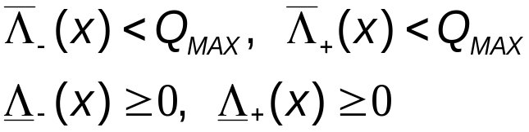
Applications
CP on Resources: Balance constraint
Reservoir Balance Propagation
  Safe event: An event x is said to be safe if and only if
  Property: If all the events are safe, then any instantiation of the time variables that satisfies the precedence constraints also satisfies the reservoir constraint. In other words, the current partial order is safe and the reservoir is “solved”.
Notes:
On a unary resource, an easy way to characterize a solution is that all the activities on the resource must be ordered. It allows to define the notion of rank of an activity in a solution.
Using this notion of rank, we can easily distinguish between the search procedures based on activity interactions on unary resources ;
1. Chronological Ranking selects at each search node an activity to be ranked first (before all the other ones) among the ones that are still unranked. In case of failure, the alternative is to enforce that at least one of the unranked activities executes before the selected one. Of course anti-chronological ranking may also be used.
2. Pair Sequencing selects at each search node a pair of activities to be sequenced one just after the other. In case of failure the alternative consists in enforcing that at least one activity is executed between the two selected ones. This family of goal is useful when dealing with transition costs.
3. Pair Ordering selects at each search node a pair of activities to be ordered. In the left branch it enforces one ordering of the activities and, in case of failure, in the other branch it enforce the other ordering. Note that pair ordering is the only search procedure that ensures that the constraints posted on the left and on the right branch are of the same nature (both are precedence relations).
In the next slides, we will propose two new instances of very simple search procedures based on Pair Ordering.

Slide 126
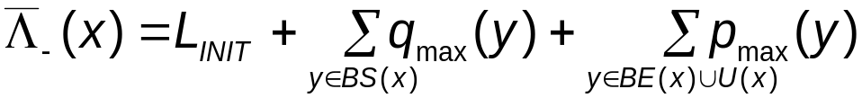
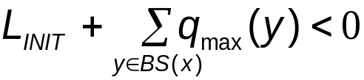

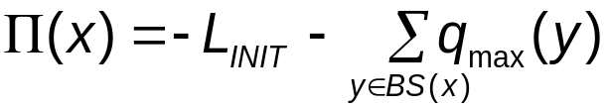
Applications
CP on Resources: Balance constraint
Reservoir Balance Propagation
  Reservoir balance equation:
  In case the first part of the equation is such that:
  It means that some events in will have to be executed strictly before x in order to produce at least:
Notes:
On a unary resource, an easy way to characterize a solution is that all the activities on the resource must be ordered. It allows to define the notion of rank of an activity in a solution.
Using this notion of rank, we can easily distinguish between the search procedures based on activity interactions on unary resources ;
1. Chronological Ranking selects at each search node an activity to be ranked first (before all the other ones) among the ones that are still unranked. In case of failure, the alternative is to enforce that at least one of the unranked activities executes before the selected one. Of course anti-chronological ranking may also be used.
2. Pair Sequencing selects at each search node a pair of activities to be sequenced one just after the other. In case of failure the alternative consists in enforcing that at least one activity is executed between the two selected ones. This family of goal is useful when dealing with transition costs.
3. Pair Ordering selects at each search node a pair of activities to be ordered. In the left branch it enforces one ordering of the activities and, in case of failure, in the other branch it enforce the other ordering. Note that pair ordering is the only search procedure that ensures that the constraints posted on the left and on the right branch are of the same nature (both are precedence relations).
In the next slides, we will propose two new instances of very simple search procedures based on Pair Ordering.

Slide 127



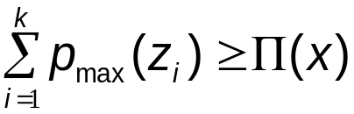

Applications
CP on Resources: Balance constraint
Reservoir Balance Propagation
  Some events will have to be executed strictly before x in order to produce at least
  Let the set of production events in
  sorted by increasing minimal time
  Let k be the smallest index such that:
  Then:
Notes:
On a unary resource, an easy way to characterize a solution is that all the activities on the resource must be ordered. It allows to define the notion of rank of an activity in a solution.
Using this notion of rank, we can easily distinguish between the search procedures based on activity interactions on unary resources ;
1. Chronological Ranking selects at each search node an activity to be ranked first (before all the other ones) among the ones that are still unranked. In case of failure, the alternative is to enforce that at least one of the unranked activities executes before the selected one. Of course anti-chronological ranking may also be used.
2. Pair Sequencing selects at each search node a pair of activities to be sequenced one just after the other. In case of failure the alternative consists in enforcing that at least one activity is executed between the two selected ones. This family of goal is useful when dealing with transition costs.
3. Pair Ordering selects at each search node a pair of activities to be ordered. In the left branch it enforces one ordering of the activities and, in case of failure, in the other branch it enforce the other ordering. Note that pair ordering is the only search procedure that ensures that the constraints posted on the left and on the right branch are of the same nature (both are precedence relations).
In the next slides, we will propose two new instances of very simple search procedures based on Pair Ordering.

Slide 128
Applications
CP on Resources: Balance constraint
U(x)
L_{INIT}=0
[+1,+2]
[-2,-1]
[-2,-2]
[+2,+2]
[+1,+2]
E(x)
[+0,+10]
[-5,-5]
[+1,+3]
[-5,-5]
[-5,-4]
BS(x)
BE(x)
[+1,+2]
Π(x)= 0 - (2+10) + (2+5+5+4) = 4
Notes:
On a unary resource, an easy way to characterize a solution is that all the activities on the resource must be ordered. It allows to define the notion of rank of an activity in a solution.
Using this notion of rank, we can easily distinguish between the search procedures based on activity interactions on unary resources ;
1. Chronological Ranking selects at each search node an activity to be ranked first (before all the other ones) among the ones that are still unranked. In case of failure, the alternative is to enforce that at least one of the unranked activities executes before the selected one. Of course anti-chronological ranking may also be used.
2. Pair Sequencing selects at each search node a pair of activities to be sequenced one just after the other. In case of failure the alternative consists in enforcing that at least one activity is executed between the two selected ones. This family of goal is useful when dealing with transition costs.
3. Pair Ordering selects at each search node a pair of activities to be ordered. In the left branch it enforces one ordering of the activities and, in case of failure, in the other branch it enforce the other ordering. Note that pair ordering is the only search procedure that ensures that the constraints posted on the left and on the right branch are of the same nature (both are precedence relations).
In the next slides, we will propose two new instances of very simple search procedures based on Pair Ordering.

Slide 129
Applications
CP on Resources: Balance constraint
Property : On a capacity resource, a partial schedule where all the events are safe is a solution as any solution to the STN is a solution to the reservoir
Notes:
On a unary resource, an easy way to characterize a solution is that all the activities on the resource must be ordered. It allows to define the notion of rank of an activity in a solution.
Using this notion of rank, we can easily distinguish between the search procedures based on activity interactions on unary resources ;
1. Chronological Ranking selects at each search node an activity to be ranked first (before all the other ones) among the ones that are still unranked. In case of failure, the alternative is to enforce that at least one of the unranked activities executes before the selected one. Of course anti-chronological ranking may also be used.
2. Pair Sequencing selects at each search node a pair of activities to be sequenced one just after the other. In case of failure the alternative consists in enforcing that at least one activity is executed between the two selected ones. This family of goal is useful when dealing with transition costs.
3. Pair Ordering selects at each search node a pair of activities to be ordered. In the left branch it enforces one ordering of the activities and, in case of failure, in the other branch it enforce the other ordering. Note that pair ordering is the only search procedure that ensures that the constraints posted on the left and on the right branch are of the same nature (both are precedence relations).
In the next slides, we will propose two new instances of very simple search procedures based on Pair Ordering.

Slide 130
Applications
CP on Resources: Branching Scheme
Event Pair Ordering (Discrete, Reservoir):
  Select a critical pair of events (x,y) on a resource R
  (event = time-point of an activity using R)
  Critical Pair of events : not-ordered pair of event : (x,y) such that neither x nor y is safe (in the sense of the balance constraint)
  Branch on : [t(x) < t(y)] ∨ [t(x) ≥ t(y)]
Notes:
On a unary resource, an easy way to characterize a solution is that all the activities on the resource must be ordered. It allows to define the notion of rank of an activity in a solution.
Using this notion of rank, we can easily distinguish between the search procedures based on activity interactions on unary resources ;
1. Chronological Ranking selects at each search node an activity to be ranked first (before all the other ones) among the ones that are still unranked. In case of failure, the alternative is to enforce that at least one of the unranked activities executes before the selected one. Of course anti-chronological ranking may also be used.
2. Pair Sequencing selects at each search node a pair of activities to be sequenced one just after the other. In case of failure the alternative consists in enforcing that at least one activity is executed between the two selected ones. This family of goal is useful when dealing with transition costs.
3. Pair Ordering selects at each search node a pair of activities to be ordered. In the left branch it enforces one ordering of the activities and, in case of failure, in the other branch it enforce the other ordering. Note that pair ordering is the only search procedure that ensures that the constraints posted on the left and on the right branch are of the same nature (both are precedence relations).
In the next slides, we will propose two new instances of very simple search procedures based on Pair Ordering.

Slide 131
Applications
RCPSPI with min/max time lags
Resource-Constrained Project Scheduling Problem with Inventory and min/max time lags [Neumann&Schwindt 99]
Resources: m reservoirs
Activities: n activities
Temporal constraints: min/max distance graph between activities

Slide 132
Applications
RCPSPI with min/max time lags
Resource usage: each activity produces and/or consumes one or several reservoirs (q constant)
Objective function: minimize makespan

Slide 133
Applications
RCPSPI with min/max time lags
d_{max}
-d_{min}

Slide 134
Applications
RCPSPI with min/max time lags
Propagation algorithms:
  Balance constraint on each reservoir
Branching Scheme:
  Event Pair Ordering
Heuristics:
  Based on LB and UB on levels computed by the balance constraint

Slide 135

Applications
RCPSPI with min/max time lags
Heuristics:
Risk of overflow at t(x)-ε
Q
0
Risk of underflow at t(x)-ε
Slack time of x
x
t_{min}(x)
t(x)-ε
t(x)
t_{max}(x)

Slide 136
Applications
RCPSPI with min/max time lags
Heuristics:
  Select an unsafe event x that maximizes
  crit(x) =
  Selection of an event y unranked w.r.t. x based on temporal commitment of posting t(x)<t(y) and t(x)≥t(y)
risks of under/overflow(x)
slack_time(x)

Slide 137
Applications
RCPSPI with min/max time lags
Heuristics:
  temporal commitment of posting t(x) < t(y):
t_{max}(y)
# eliminated
instances
t(y)
y
total # instances
t_{min}(y)
x
t_{min}(x)
t(x)
t_{max}(x)

Slide 138
Applications
RCPSPI with min/max time lags
Search: order pairs (x,y) until all events are safe
Results [Laborie 01]
  Tested on 12 open RCPSPI with time lags [Neumann&Schwindt 99]
  All problems were closed in less than 10s CPU time (HP-UX 9000/785 workstation)
  Produce partially ordered schedule instead of fully instantiated ones (more robust)

Slide 139
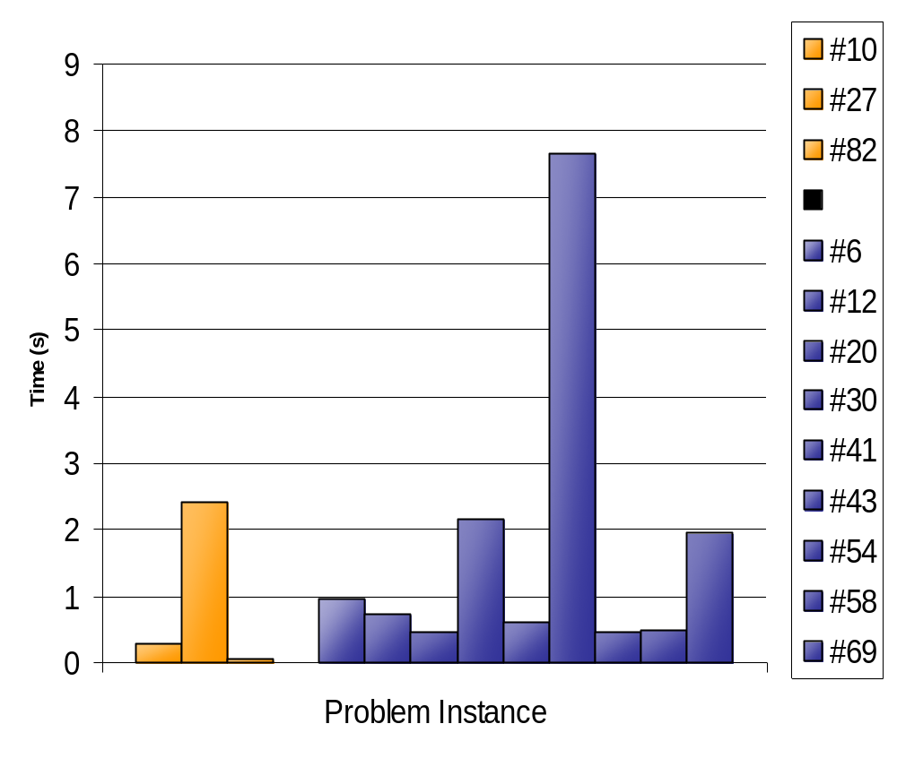
Applications
RCPSPI with min/max time lags

Slide 140
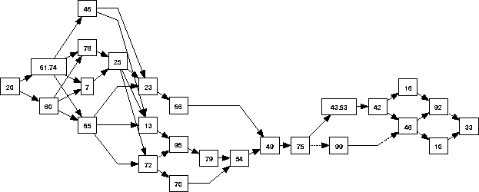
Applications
RCPSPI with min/max time lags
A part of the temporal graph of an optimal solution for #41

Slide 141
Temporal Graphs in Scheduling
Conclusion
Temporal graphs (STNs), implicitly or explicitly, are an essential ingredient of Scheduling
Propagation/maintenance of temporal graphs is closely related to shortest paths problems
There exists an extensive literature on shortest paths algorithms for both static and incremental problems

Slide 142
Temporal Graphs in Scheduling
Conclusion
Choosing the “best” algorithm is not always easy:
  Depends on the size and topology of the graph: sparse/dense, existence of cycles, existence of negative/positive delays
  Depends on the type of queries: single-source v.s. all-pairs v.s. symbolical precedence

Slide 143
Temporal Graphs in Scheduling
Conclusion
Choosing the “best” algorithm is not always easy:
  Worst case time complexity is not always a good measure: for instance O(n2^{n}) can be better in practice than O(nm)
  Static memory issues: O(n) v.s. O(n²)
  Reversible memory issues:
    Single-Source Shortest Paths: O(n)×O(n) = O(n²)
    All-Pairs Shortest Paths: O(n²)×O(n) = O(n³)
    Transitive Closure: O(n²)×O(1) = O(n²)

Slide 144
Temporal Graphs in Scheduling
References
[Dechter&al 91] R. Dechter, I. Meiri and J. Pearl. “Temporal Constraint Networks”. Artificial Intelligence, 49(1-3):61-95. (1991)
[Dijkstra 59] E.W. Dijkstra. “A Note on Two Problems in Connection with Graphs”. Numer. Math., 1:269-271 (1959)
[Goldberg 01] A.V. Goldberg. “A simple shortest path algorithm with linear average time”. In Proceedings of the 9th European Symposium on Algorithms (ESA '01), pages 230-241 (2001)
[Bellman 58] R.E. Bellman. “On a Routing Problem”. Quart. Appl. Math., 16:87-90 (1958)
[Moore 59] E.F. Moore. “The Shortest Path Through a Maze”. In Proc. Int. Symp. On the Theory of Switching, p. 285-292 (1959)
[Ford&Fulkerson 62] L.R. Ford and D.R. Fulkerson. “Flows in Networks”. Princeton Univ. Press (1962)
[Goldberg&Radzic 93] A.V. Goldberg and T. Radzic. “A Heuristic Improvement of the Bellman-Ford Algorithm”. Applied Math. Let., 6:3-6 (1993)
[Cherkassky&al 96] B.V. Cherkassky, A.V. Goldberg and T. Radzic. “Shortest Paths Algorithms: Theory and Experimental Evaluation”. Mathematical Programming, 73:129–174 (1996)
[Cormen&al 90] T.H. Cormen, C.E. Leiserson and R.L. Rivest. “Introduction to Algorithms”. MIT Press, Cambridge, MA (1990)
[Tarjan 83] R.E. Tarjan. “Data Structures and Network Algorithms”. Society for Industrial and Applied Mathematics (1983)
[Pape 74] U. Pape. “Implementation and Efficiency of Moore Algorithms for the Shortest Root Problem”. Math. Prog., 7:212-222 (1974)
[Levit 72] B.J. Levit and B.N. Livshits. “Neleneinye Setevye Transportnye Zadachi”. Transport, Moscow (1972)
[Pallottino 84] S. Pallottino. “Shortest-Path Methods: Complexity, Interrelations and New Propositions”. Networks, 14:257-267 (1984)

Slide 145
Temporal Graphs in Scheduling
References
[Ramalingam&Reps 96] G. Ramalingam and T. Reps. “On the computational complexity of dynamic graph problems”. Theoretical Computer Science, 158(1-2):233-277 (1996)
[Michel&VanHentenryck 03] L. Michel and P. Van Hentenryck. “Maintaining Longest Paths Incrementally”. Proc. CP-03. (2003)
[Gerevini&al 96] A. Gerevini, A. Perini and F. Ricci. “Incremental algorithms for managing temporal constraints”. Proc. 8th IEEE Conf. on Tools with Artificial Intelligence. (1996)
[Cesta&Oddi 01] A. Cesta and A. Oddi. “Algorithms for Dynamic Management of Temporal Constraints Networks”. (2001)
[Frigioni&al 03] D. Frigioni, A. Marchetti-Spaccamela and U. Nanni. “Fully dynamic shortest paths in digraphs with arbitrary arc weights”. J. Algorithms 49(1): 86-113 (2003)
[Warshall 62] S. Warshall. “A theorem on Boolean matrices”. Journal of ACM, 9(1):11-12. (1962)
[Nuutila 94] E. Nuutila. “An efficient transitive closure algorithm for cyclic digraphs”, Information Processing Letters 52. 207-213. (1994)
[Tarjan 72] R.E. Tarjan. “Depth first search and linear graph algorithms”. SIAM Journal of Computing, 1(2):146,160. (1972)
[Ausiello&al 91] G. Ausiello, G. Italiano, A. Marchetti-Spaccamela and U. Nanni. “Incremental Algorithms for Minimal Length Paths”. Journal of Algorithms 12:615-638. (1991)
[Italiano 86] G.F. Italiano. “Amortized efficiency of a path retrieval data structure”. Theoretical Computer Science, 48:273-281. (1986)
[Neumann&Schwindt 99] K. Neumann and C. Schwindt. “Project scheduling with inventory constraints”. Tech. Report WIOR-572, Institut für Wirtschaftstheorie und Operations Research. Universität Karlsruhe. (1999)
[Laborie 01] P. Laborie. “Algorithms for propagating resource constraints in AI planning and scheduling: existing approaches and new results”. Artificial Intelligence. 143(2):151 – 188. (2003)

